Slide 1


Chapter Nine
Human Capital Theory: Applications to Education and Training
Prepared by Dr. Mir Ahasan Kabir
York University

Slide 2
Learning Objectives
Discuss how the decision to invest in human capital (schooling or on-the-job training) can be analyzed as a standard investment decision based on a comparison between the costs and benefits of the investment.
Explain how the most expensive part of an investment in human capital is the opportunity cost of one’s time.
Explain why trying to estimate the monetary return to education by simply comparing the earnings of more- and less-educated workers can be misleading due to the ability bias, or because education is used as a “signal” in the labour market.
Describe how the return to education is quite large and has been increasing over time in Canada.
Discuss the circumstances under which either workers or employers are the ones who should pay for training programs.
© 2021 MCGRAW-HILL EDUCATION LTD.
9 - <number>

Slide 3
Main Questions
Why are more-educated workers generally paid more than less-educated workers?
What factors determine the market rate of returns to education?
If education is such a worthwhile investment, why doesn’t everyone have a Ph.D.?
Are more-educated people paid more because of the learning they acquired, or do higher levels of education merely indicate these individuals’ inherently greater productivity?
What is labour market signalling and screening?
© 2021 MCGRAW-HILL EDUCATION LTD.
9 - <number>

Slide 4
Main Questions
How might education serve a role as a signal? If education is used primarily as a screening device, why might the private and social rates of return to education diverge?
Should the government subsidize early childhood learning programs?
Are government-funded training programs worth the money?
© 2021 MCGRAW-HILL EDUCATION LTD.
9 - <number>

Slide 5
Human Capital Theory
Investments are made to improve productivity and earnings
Costs incurred with the expectation of future benefits
Benefits must exceed costs
© 2021 MCGRAW-HILL EDUCATION LTD.
9 - <number>

Slide 6
Human Capital Theory
Opportunity cost
Private Costs and Benefits
Social Costs and Benefits
Real Costs
Transfer Costs
© 2021 MCGRAW-HILL EDUCATION LTD.
9 - <number>

Slide 7
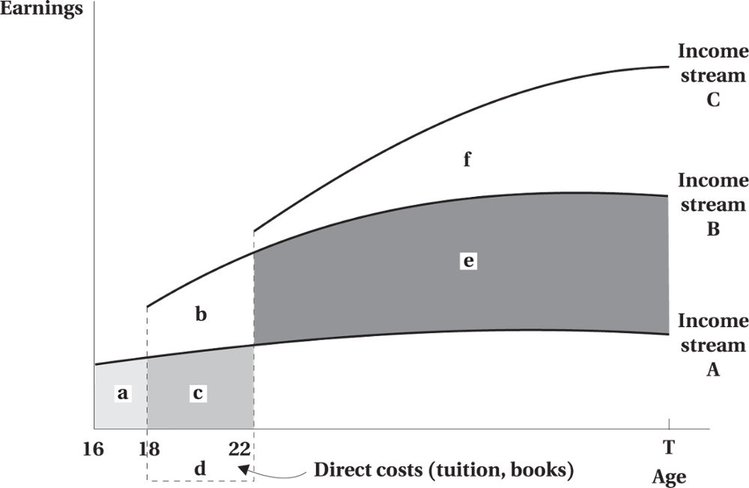
Private Investment in Education
Figure 9.1 Education and Alternative Income Streams
© 2021 MCGRAW-HILL EDUCATION LTD.
9 - <number>

Slide 8
Private Investment in Education
Age-Earnings Profiles
Common attributes:
  Increase with age but at a decreasing rate
  Higher for those with more education
© 2021 MCGRAW-HILL EDUCATION LTD.
9 - <number>

Slide 9
Private Investment in Education
Optimal Human Capital Investment
Simplifying assumptions:
No direct (consumption) utility or disutility from education
Hours of work are fixed
Income streams associated with education amounts are known
Individuals can borrow and lend at the real interest rate (perfect capital markets)
© 2021 MCGRAW-HILL EDUCATION LTD.
9 - <number>

Slide 10
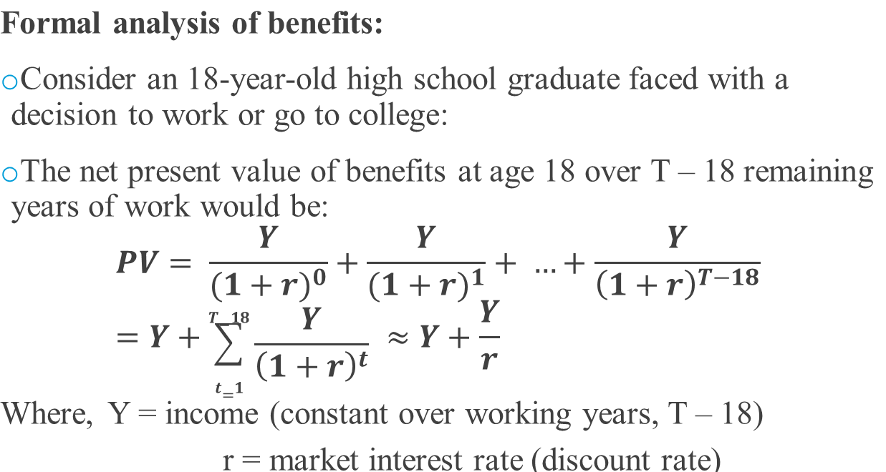
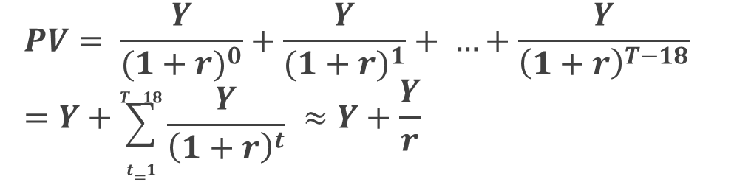
Private Investment in Education
Formal analysis of benefits:
Consider an 18 year-old high school graduate faced with a decision to work or go to college.
The net present value of benefits at age 18 over T – 18 remaining years of work would be:
Where, Y = income (constant over working years, T – 18)
r = market interest rate (discount rate)
© 2021 MCGRAW-HILL EDUCATION LTD.
9 - <number>

Slide 11
Private Investment in Education
The optimal investment in human capital is determined by comparing the costs and the benefits of having and additional year of education, using the following concepts:
    Marginal costs and benefits of education
    Rate of return on investment in education
© 2021 MCGRAW-HILL EDUCATION LTD.
9 - <number>

Slide 12
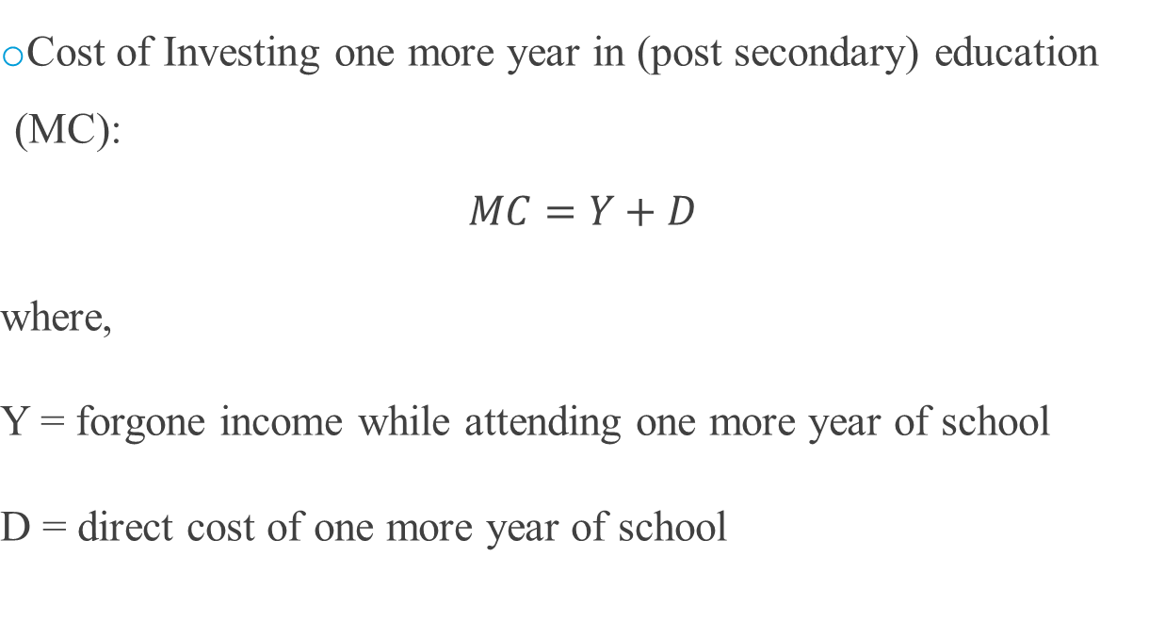

Private Investment in Education
Cost of investing one more year in (post secondary) education (MC):
where,
Y = forgone income while attending one more year of school
D = direct cost of one more year of school
© 2021 MCGRAW-HILL EDUCATION LTD.
9 - <number>

Slide 13
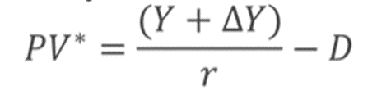
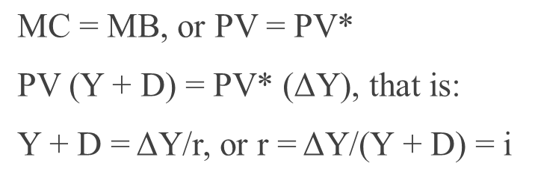
Private Investment in Education
Total Benefit of one more year of school:
where ΔY = increase in income due to extra year of schooling (MB)
Optimum quantity (# of years) of education will be achieved when:
where i = the internal rate of return
© 2021 MCGRAW-HILL EDUCATION LTD.
9 - <number>

Slide 14
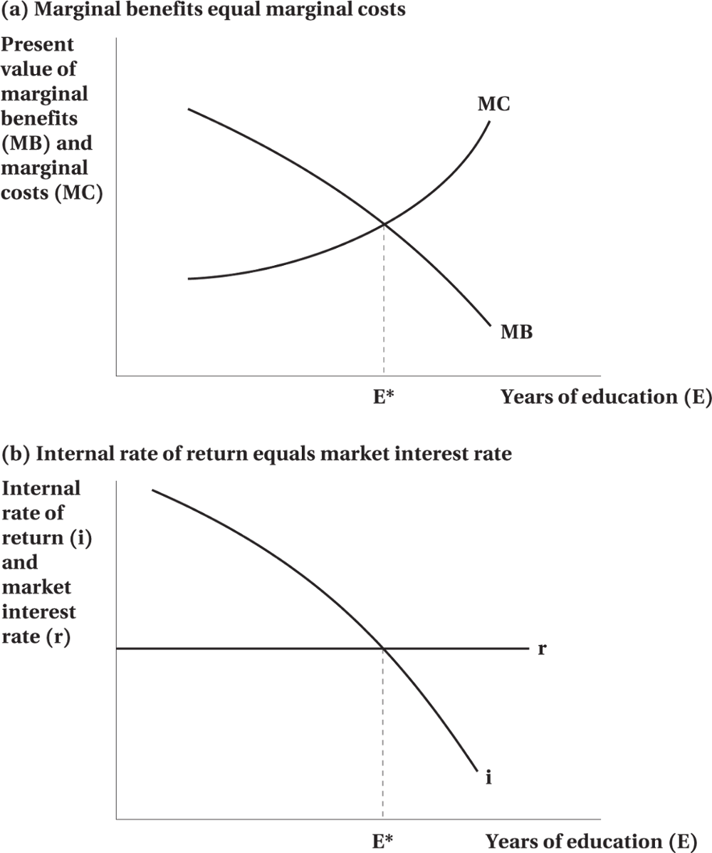
Private Investment in Education
Figure 9.2 Two Ways of Stating the Decision Rule for Optimal Human Capital Investment
© 2021 MCGRAW-HILL EDUCATION LTD.
9 - <number>

Slide 15
Private Investment in Education
To maximize the net present value of lifetime earnings:
  Increase education until…
  Present value of benefits of additional year (MB) equals present value of additional costs (MC), or
  i = r
  where: i = internal rate of return
    r = market interest rate
© 2021 MCGRAW-HILL EDUCATION LTD.
9 - <number>

Slide 16
Private Investment in Education
Private Investment in Education
Implications of Theory
Investment should be made early in one’s life
Little incentive for individuals experiencing discontinuity in the workforce
Investment in education and progressive tax system
© 2021 MCGRAW-HILL EDUCATION LTD.
9 - <number>

Slide 17
Private Investment in Education
Factors Influencing Education
Income tax
  Increase in progressivity of taxes reduces demand for education
Student loans
  Alter marginal cost of education and levels of educational attainment (increase in productivity will benefit both the society and the individual)
© 2021 MCGRAW-HILL EDUCATION LTD.
9 - <number>

Slide 18
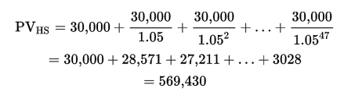
Private Investment in Education
Worked Example
Computing the Returns to Education
Mary is an 18-year-old high school graduate who can take a job paying $30,000 without further education. The prevailing interest rate is 5 percent. Mary plans to work from age 18 until retirement at age 65.
© 2021 MCGRAW-HILL EDUCATION LTD.
9 - <number>

Slide 19

Private Investment in Education
We can approximate a stream of future income Y using the formula Y/r, which is based on the idea that Mary would never retire and work forever.
© 2021 MCGRAW-HILL EDUCATION LTD.
9 - <number>

Slide 20
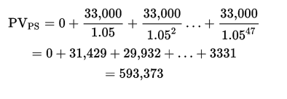
Private Investment in Education
After completing a one-year post-secondary program, Mary would earn $33,000
The extra year of schooling increases the present value of future income by $23,943
© 2021 MCGRAW-HILL EDUCATION LTD.
9 - <number>

Slide 21
Private Investment in Education
Compute the internal rate of return using the formula i = ΔY/(Y + D).
  When there are no direct costs (D = 0), i = 3000/30,000 = 10 percent.
  If D =$3000, the internal rate of return is about 9 percent , 3000/(30,000 + 3000)
  Direct costs have to go up to $30,000 for Mary not to undertake the investment
© 2021 MCGRAW-HILL EDUCATION LTD.
9 - <number>

Slide 22
Education as a Filter
Education acts as a signal of the productivity of employees
Higher wages are offered if employers believe that education increases productivity
© 2021 MCGRAW-HILL EDUCATION LTD.
9 - <number>

Slide 23
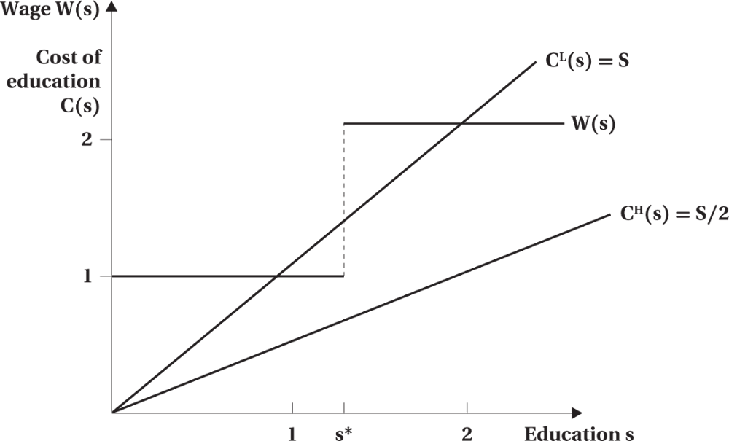
Education as a Filter
Figure 9.3 Offered Wage and Signalling Cost Schedules
© 2021 MCGRAW-HILL EDUCATION LTD.
9 - <number>

Slide 24
Empirical Evidence:
Education and Earnings
Earnings increase with age experience
Increase is most rapid to age 40 or 44 for individuals with the most education
Differential is wider between groups at age 50 than 20–30
© 2021 MCGRAW-HILL EDUCATION LTD.
9 - <number>

Slide 25
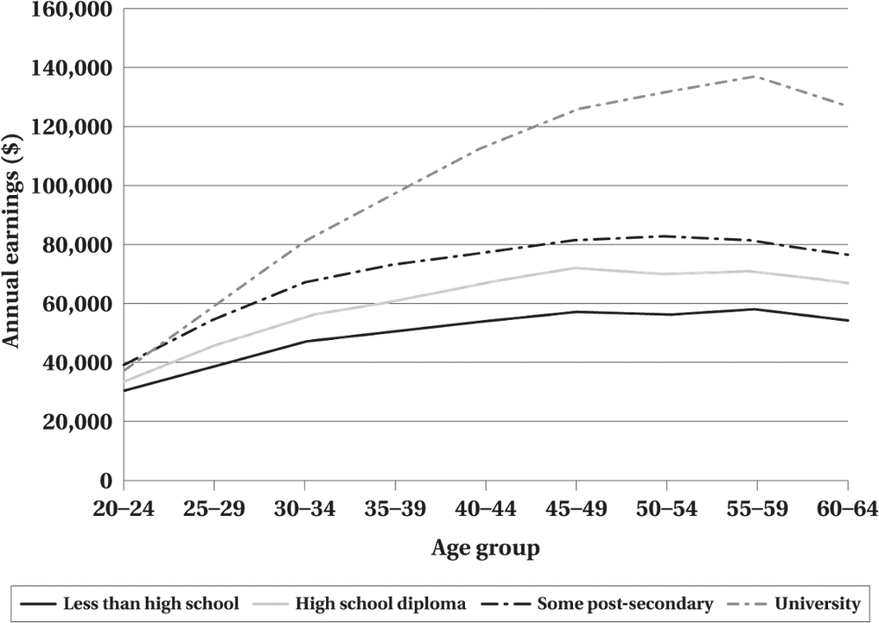
Empirical Evidence:
Education and Earnings
Figure 9.4 Earnings by Age and Education, Canadian Males, 2015
© 2021 MCGRAW-HILL EDUCATION LTD.
9 - <number>

Slide 26
Empirical Evidence:
Education and Earnings
Table 9.1 Estimates of the Private Returns¹ to Schooling in Canada, 2000
Level of Schooling | Males | Females
Bachelor’s degree² | 12 | 14
Master’s degree | 3 | 5
Ph.D. | nc² | 4
Medicine | 21 | 22
Bachelor’s Degree by Field of Study | Males | Females
Education | 9 | 14
Humanities and fine arts | nc | 10
Social sciences³ | 11 | 14
Commerce | 9 | 19
Natural sciences | 9 | 8
Engineering and applied science | 9 | 14
Health sciences | 18 | 18
© 2021 MCGRAW-HILL EDUCATION LTD.
9 - <number>

Slide 27
Empirical Evidence: Human Capital Earnings Function
Estimates the rate of return to education
Controls for other factors that may affect earnings such as ability and experience
Ln Y= α + rS + β1EXP + β2EXP² + ε
Where:
Y = Earning; α = Fixed component of wage with no schooling;
r = i = internal rate of return;
S = Years of schooling;
EXP = Age as a proxy for Experience;
ε = Random variable (motivation, luck, etc.)
© 2021 MCGRAW-HILL EDUCATION LTD.
9 - <number>

Slide 28
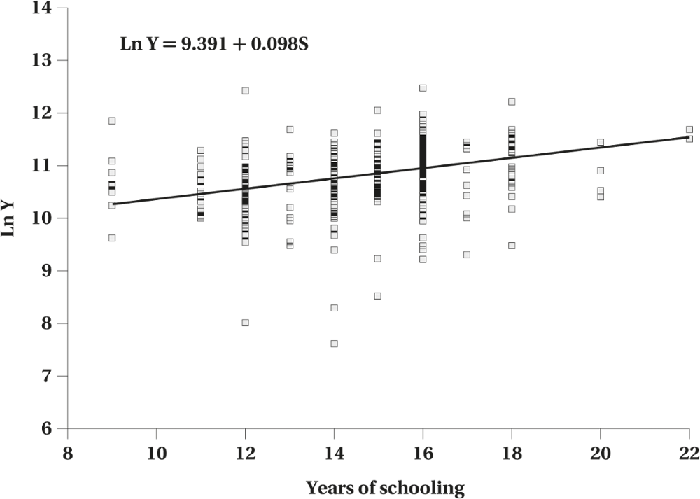
Empirical Evidence: Human Capital Earnings Function
Figure 9.5 Log Earnings by Years of Schooling, Women 35 to 39 Years of Age, 2015
© 2021 MCGRAW-HILL EDUCATION LTD.
9 - <number>

Slide 29
Empirical Evidence: Human Capital Earnings Function
Table 9.2 Estimated Returns to Schooling and Experience, 2015 (dependent variable: log annual earnings)
 | Men | Women
Intercept | 9.232 (714.15) | 8.605 (628.29)
Years of schooling | 0.080 (105.31) | 0.114 (140.77)
Experience | 0.054 (75.96) | 0.041 (62.51)
Experience squared | − 0.0009 (60.14) | − 0.0006 (43.85)
R-squared | 0.136 | 0.204
Sample size | 121,947 | 99,398
© 2021 MCGRAW-HILL EDUCATION LTD.
9 - <number>

Slide 30
Empirical Evidence: Signalling, Screening, and Ability
Determinants difficult to control
  innate ability, motivation, perseverance, tolerance, etc.
Education as Signaling/Screening
Private returns on education
Social returns on education
© 2021 MCGRAW-HILL EDUCATION LTD.
9 - <number>

Slide 31
Empirical Evidence:
Addressing Ability Bias
Natural experiments
  Isolate the influence of education from unobserved ability factors
  Research on twins
  Compulsory school attendance laws
  Proximity to college findings
© 2021 MCGRAW-HILL EDUCATION LTD.
9 - <number>

Slide 32
Empirical Evidence
Our initial intuition that the returns to education were overstated because of ability bias, was exaggerated.
The returns to education discussed are restricted to the private monetary benefits.
The social returns to education may differ from the private returns
© 2021 MCGRAW-HILL EDUCATION LTD.
9 - <number>

Slide 33
Social Returns to Education
Natural Experiments based on regional differences in educational achievement to estimate the social return to education.
Education has a favourable impact on a variety of outcomes other than earnings.
© 2021 MCGRAW-HILL EDUCATION LTD.
9 - <number>

Slide 34
Increased Returns to Education and Inequality
Increased returns to education have coincided with more-general increases in income inequality in society.
The link between earnings inequality and returns to schooling is not quite complete.
  Incidence of Unemployment
  Wage Inequality within Education Groups
© 2021 MCGRAW-HILL EDUCATION LTD.
9 - <number>

Slide 35
Increased Returns to Education and Inequality
Increasing Returns to Education Since 1980
There was little change in returns to schooling in the 1980s and early 1990s.
The return to education has increased substantially since the mid-1990s.
Demand-side of factors play an important for the increasing returns to education.
  Polarization of Wages
  Earnings at the very top have increased so much more than in the rest of the labour market.
© 2021 MCGRAW-HILL EDUCATION LTD.
9 - <number>

Slide 36
Training
General Training
Skills used in various firms
Firms will offer higher wages for this training
Trainee is willing to bear the cost since higher wages are offered for these skills
Specific Training
Training useful to the firm that provides the training
Trainee is unwilling to bear the cost because there are no higher earnings
Firm does not have to pay higher wages because other firms are not competing for such trainees
© 2021 MCGRAW-HILL EDUCATION LTD.

Slide 37
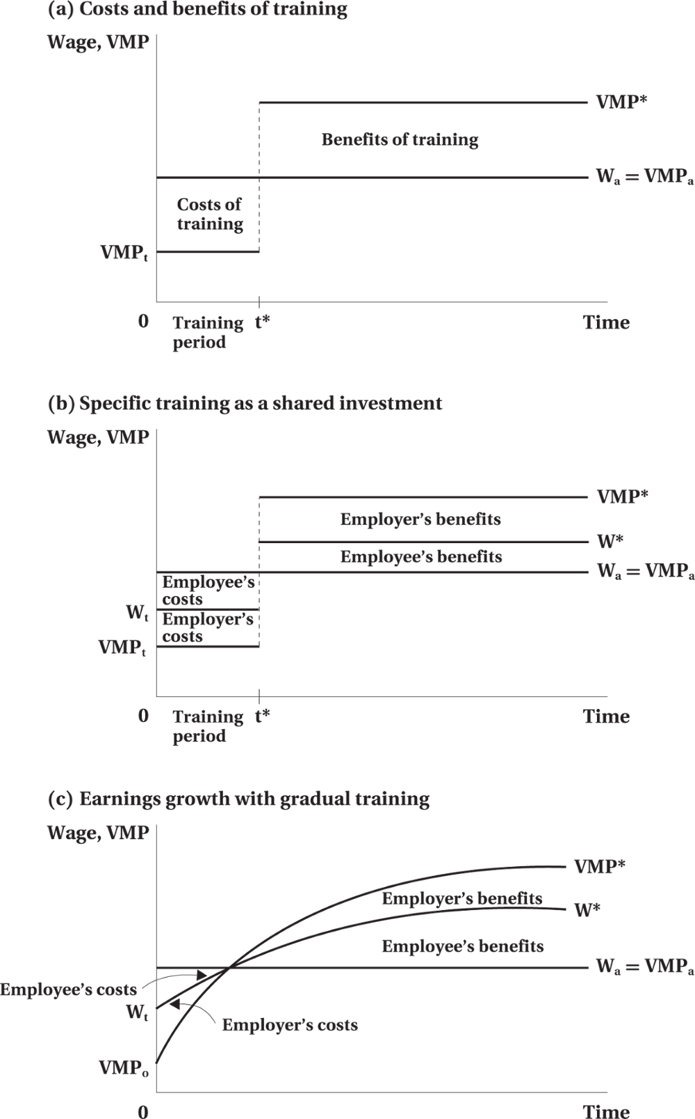
Training
Figure 9.6 Costs, Benefits, and Financing of Training
© 2021 MCGRAW-HILL EDUCATION LTD.
9 - <number>

Slide 38
Training:
Appropriate Role of Government
Private markets may not provide socially optimal amounts of training:
  Imperfect information
  Regulatory restrictions
Training subsidies to disadvantaged could:
  Increase working hours
  Raise wages above the poverty line
© 2021 MCGRAW-HILL EDUCATION LTD.
9 - <number>

Slide 39
Chapter Summary
Investment in human capital
Education and alternative age earnings profiles
Education and labour productivity
The human capital earnings function
Education as a signalling factor
Empirical results and the ability bias
On-the-job training
Government training programs
© 2021 MCGRAW-HILL EDUCATION LTD.
9 - <number>

